Slide 1
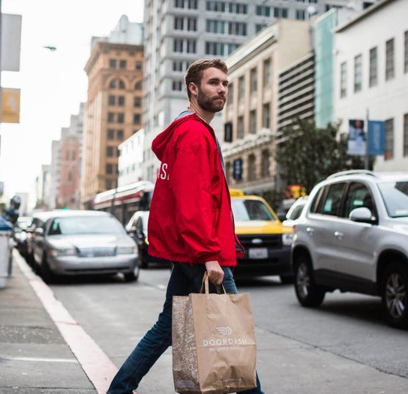
Environmental Assessment
Hanna Daminski,Rachel Hagerman, Jenifer Jackson, Andrew Mcleod, & Bryce Bowles

Slide 2
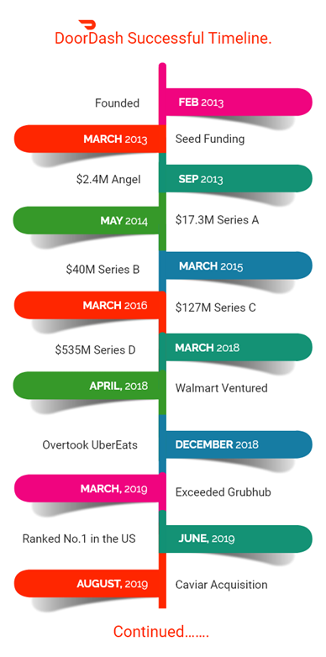
History
2004 - GrubHub started
2011 - Postmates started
Fall of 2012 by 4 Stanford University students created PaloAltoDelivery.com (DoorDash)
Developers were getting feedback on an app they built and came across the idea
Vision was to build a local, on-demand logistics company
Became DoorDash in June 2013
2014 - UberEats started
Dec 2016 - DoorDash Drive (Large ordering)
April 24, 2018 – Walmart Partnership (Delivery for grocery and non-Food Items)
Jan 2019 – General Motors partnership (Self-Driving Cars)
June 2019 - Largest market share of food delivery in the united states
Oct 2019 - DoorDash opened its first ghost kitchen
Aug 5, 2020 - Introduces DashMart (convenience/grocery items)
Nov 2020 DoorDash opened its first physical restaurant called Burma Bites
December 9, 2020 DoorDash IPO, raising $3.37 billion
Acquisitions include Scotty Labs (Aug 2019 - self-driving and remote-controlled vehicle technology), Caviar (Oct 2019 - upscale urban-area restaurant delivery), and Chowbotics (Feb 2021 - food prep automation)
Europe (as of April 30, 2021)
Jun 9, 2021 - DoorDash Expands to Japan
Notes:
Lets take a look at the short history of DoorDash
Now on the right, we have a graph of the funding timeline.
https://medium.com/@DoorDash/the-doordash-story-b370c2bb1e5f
https://larskamp.medium.com/how-doordash-built-the-most-incredible-go-to-market-playbook-ever-5e8f1d58f6cd
https://appther.com/blog/doordash-business-model-how-does-doordash-make-money/
https://progressivegrocer.com/doordash-will-be-3rd-largest-e-commerce-banner-after-amazon-walmart-report
https://larskamp.medium.com/how-doordash-built-the-most-incredible-go-to-market-playbook-ever-5e8f1d58f6cd

Slide 3


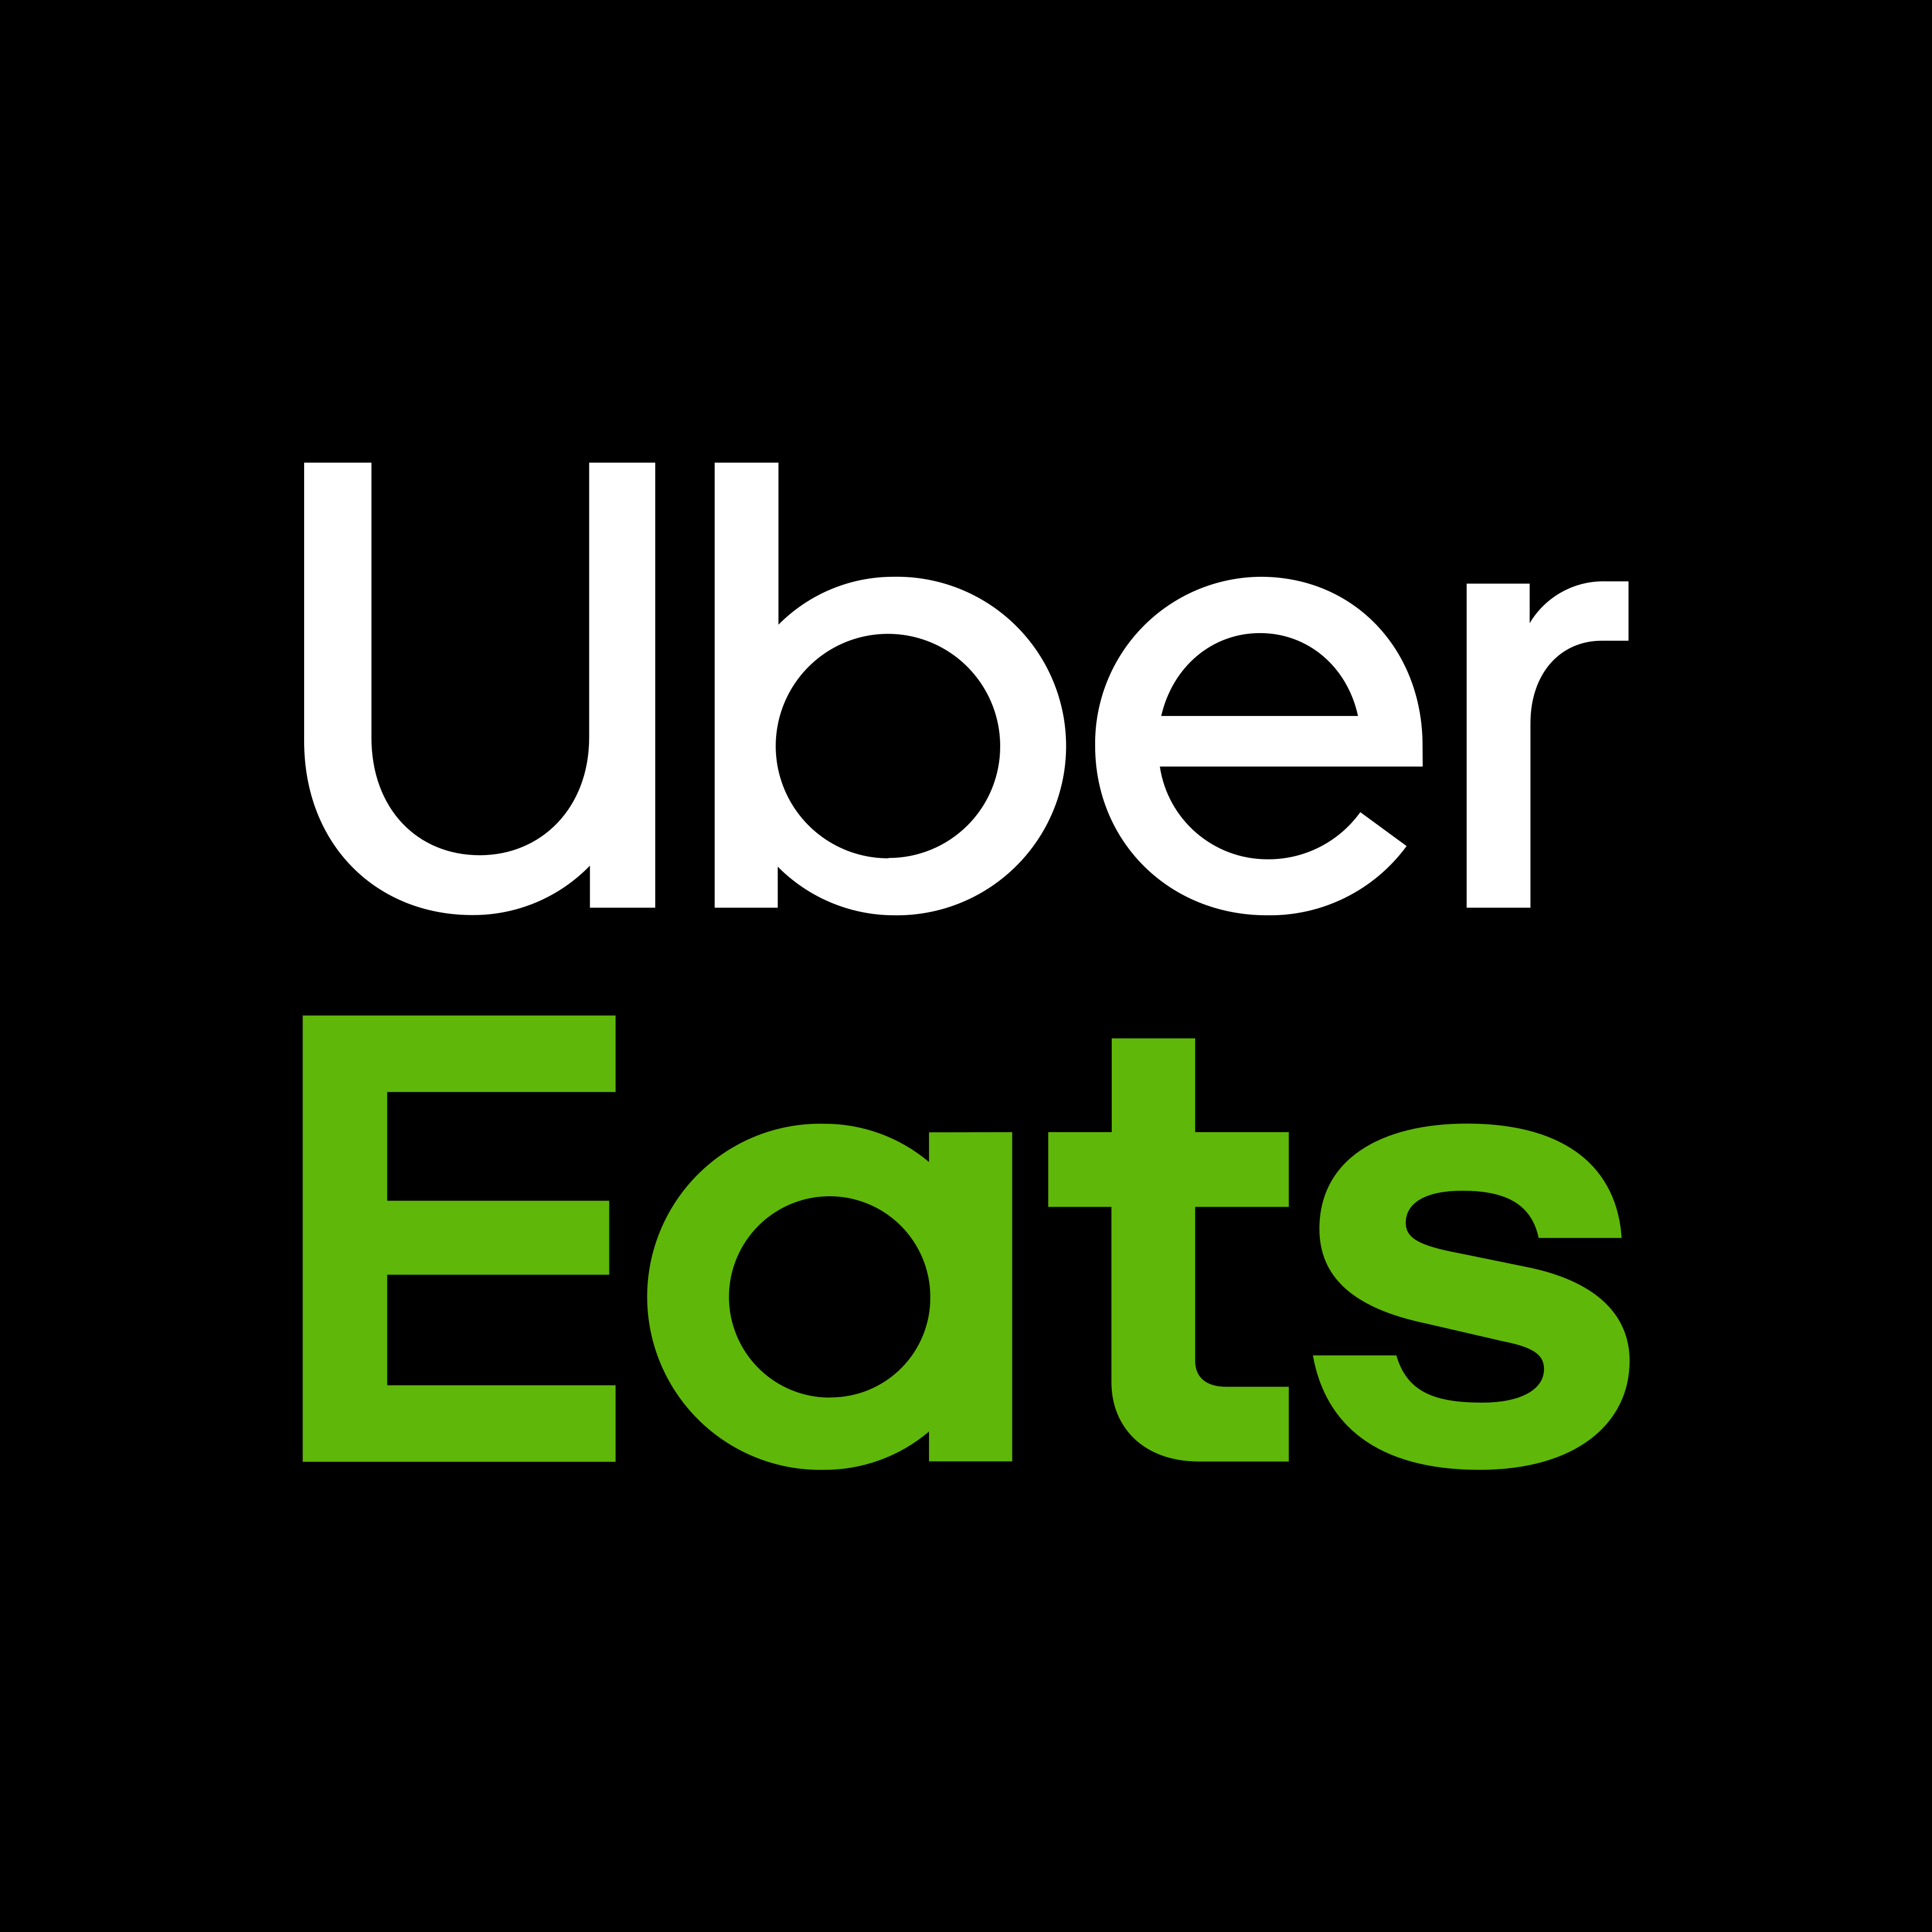
 | GrubHub | DoorDash | UberEats
Slogan | "Moving Eating Forward" | "It's Our Pleasure" | "Get the Food you want"
Best For | Deals | Quality | Variety
Location | 4,000+ U.S. Cities & London | 4,000+ cities & Canada, including Atlanta, Seattle, Boston, New York, and Chicago | 6,000+ cities and 45 countries
Audience | Urban/City | Urban/City & Suburban | Urban/City
Brand Culture | Enrich communities in which local businesses operate. | Delivering good by connecting people, and possibility. | Easy way to get the food you love delivered.
Delivery Fee | Typically, less than $7 | $0-$8 | $1-$10
Subscription | Grubhub+: $9.99 per month (free two-week trial); unlimited free delivery from eligible restaurants and 10% cashback for every $100 you spend | DashPass: $9.99 per month (free one-month trial); zero delivery fees on orders from select restaurants, as well as zero delivery fees and lower service fees on orders over $12 | Eats Pass: $9.99 per month, unlimited free delivery (even during busy hours) and 5% off orders of $15 or more for your region
Also Delivers | Alcohol & Convenience | Prescription, Convenience, Groceries and Alcohol | Alcohol (Only in South Florida)
Brand Positioning Assessment
Notes:
Please comment on if their culture is healthy or not --- could talk employee dissatisfaction being an issue
(from survey) Of those that ordered 7+ times in the past 60 days, 177 said DoorDash was their favorite, 122 said Uber, 83 said Grub and 89 said N/A (most of these only order direct). Because of subscription and lower fees on larger orders and Chase relationship? This is the customer segment that they do best with. This could help answer "who are their customers."
Make sure to check the slide screenshot into our doc. It lists several questions we should address in slide 3 and 4 like "how does the brand position itself within the industry" and "who are their customers" and "does their brand possess a healthy culture."
GrubHub – 4,000 cities
Uber eats – 6,000 cities / 45 countries
Grub Hub offers groceries and convenience stores
UberEats offers groceries
“You don’t have to be a business expert to understand that businesses without differentiated offerings struggle to charge prices above the cost of the service,” New Constructs said. “In other words, they never turn a profit.”

Slide 4
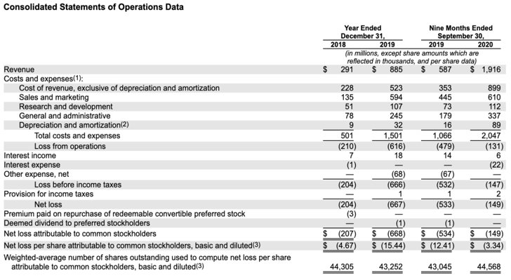
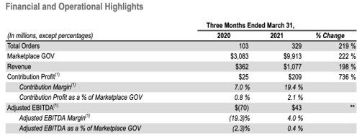
Financial Assessment
The first chart illustrates there was a significant amount of order growth from 2019-2021.
Revenue increased by 241% from 2019- 2021, from $885 million to 1.92 billion.
The growth was driven by consumer retention, new consumers, new market expansion, COVID-19, and an increase number of orders through the app.
After completing the Initial Public Offering (IPO), DoorDash Stock price opened at $182, 80% above its IPO price, providing the company with a $60 billion market cap.
DoorDash Stock Price Today at June 17, 2021 reduced to $164.52 per share.
Notes:
INCREASED BY 241 FROM 2019 - 2021

Slide 5
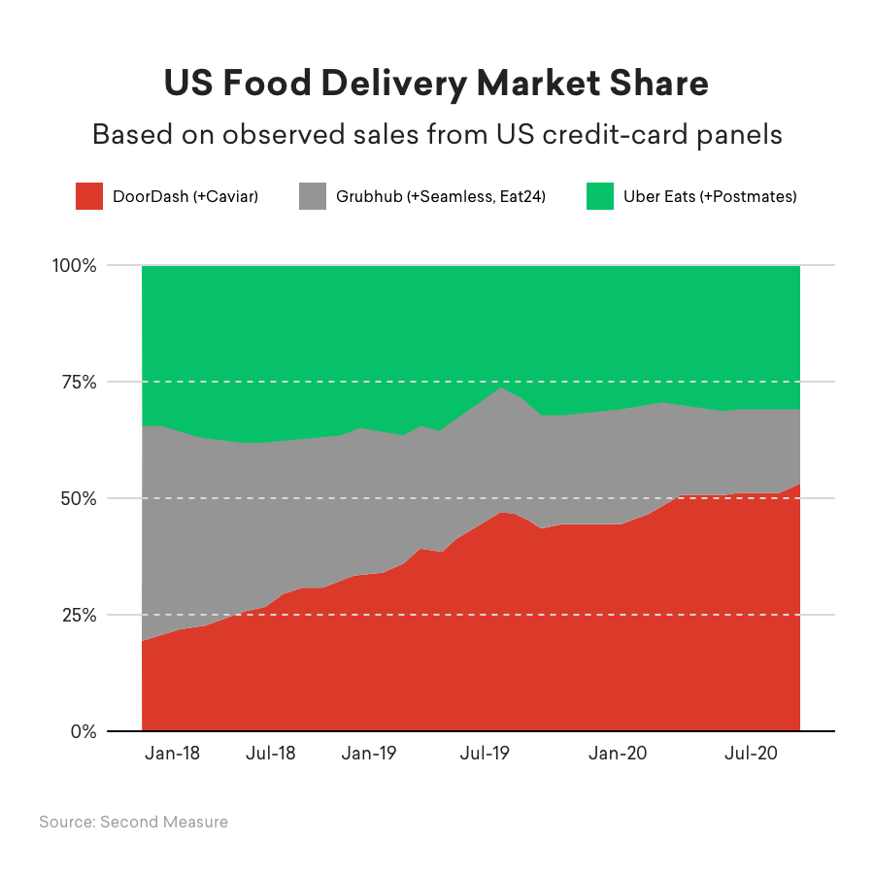
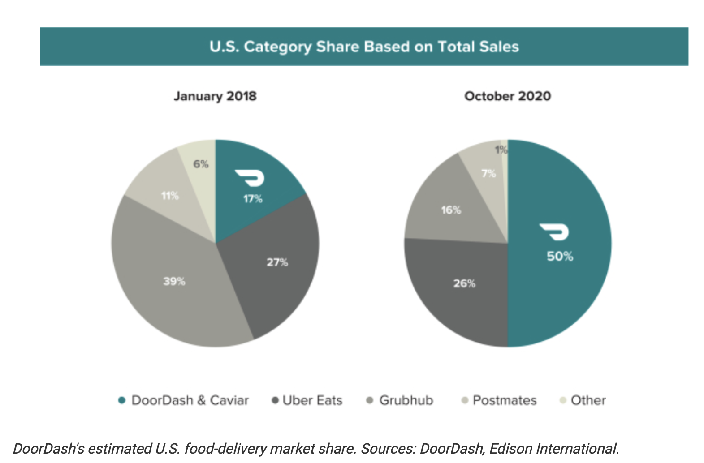
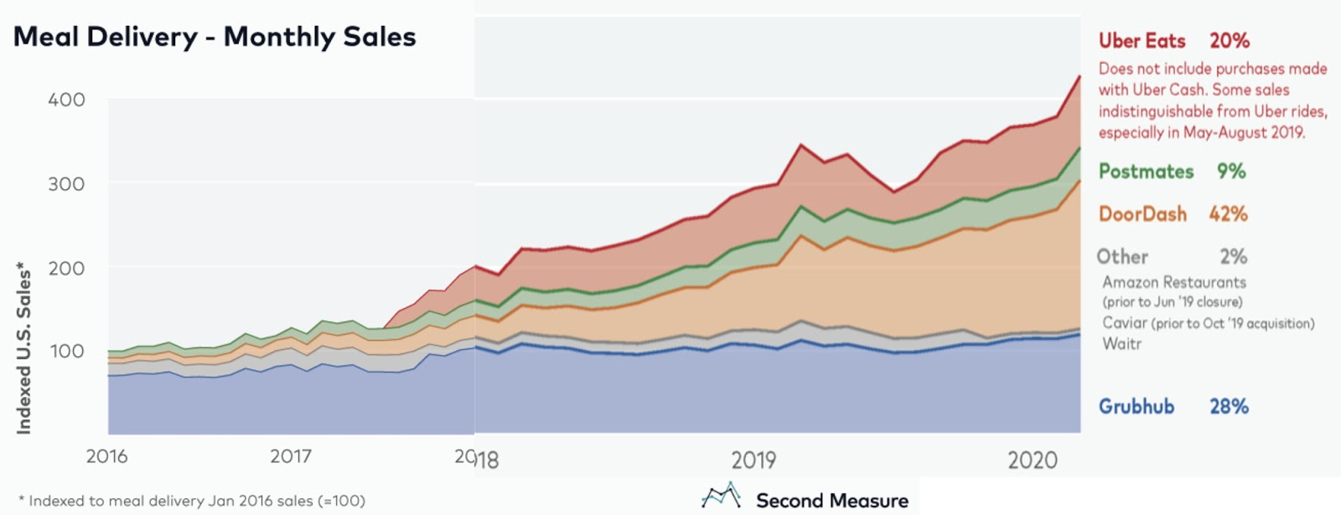
Performance Assessment
DoorDash leading the industry in sales with 56%
DoorDash holds 50% market share nationally
Focusing on suburban and metropolitan areas attributed to their 35% market share increase from 2018-2020.
Notes:
Can we tie in any of the metrics that we identified as important last presentation? Especially how their service compares to other brands
Can we find something that shows profit in addition to revenues? Stock price over time? Please add these!

Slide 6
SWOT Analysis- DoorDash
Strengths
High brand recognition
Weaknesses
Low employee satisfaction
The survey showed that it had the highest brand recognition at 91.4%
Largest portion of market share in the US
In April 2021 DoorDash's market share was 56%
Strong use of data analytics
Lack of profitability & loyalty (high competition)
high cost of customer acquisition
High fees to customers and high commission percentages to suppliers
Low customer service ratings
Diversification into new geographic regions
Opportunities
Diversification into adjacent products or services
Innovation including Autonomous Delivery
Expand globally
Threats
Increased Regulation (reclassifying their employees, listing restaurants without permission, caps on fees)
Local Competition
Consumer preference to buy direct from the restaurant
New competition (local and franchised companies often restaurant backed)
Other delivery based businesses spreading into restaurant delivery
Price Wars with other industry leaders
The proportion of DoorDash employees with the word "data" in their title is approximately 2-3 times that of similar brands

Slide 7
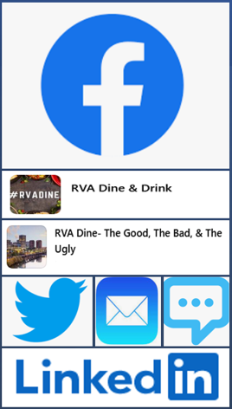
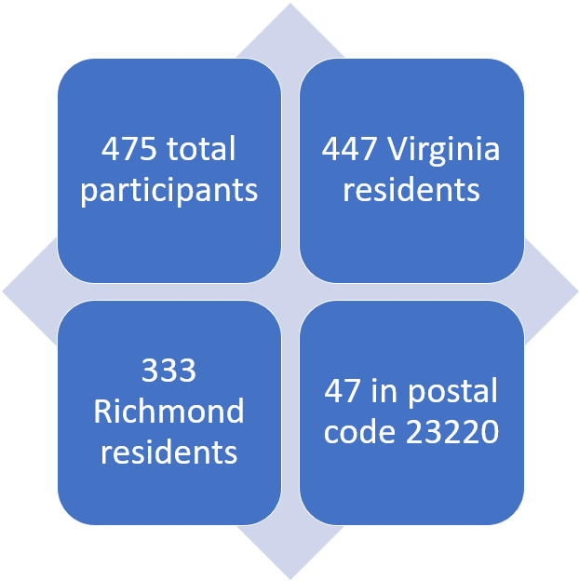
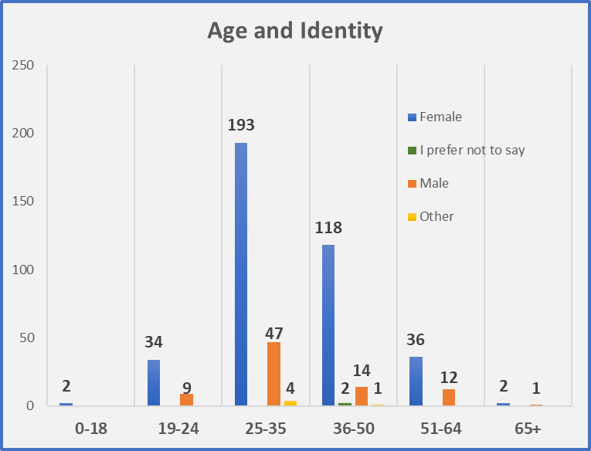
Primary Research: Survey
Respondents are 80% Female and 51% are between 25 and 35 years old
Notes:
Once we had our first hypotheses from our initial SWOT meeting, we designed questions to test these hypothesees. Based on the survey results, we revisited the SWOT to tweak it to what we just presented. Our survey consisted or 10 or 11 questions based on how you answered. One question had 3 answers and 1 answer would allow you to continue with the survey while the other two took you to different questions first. The survey had a combination of multiple choice, multiple answer, and open-ended (short answer) questions. 3 demographic questions were included in the survey. We posted the survey through facebook, twitter, linkedin plus sent by email and text. We posted to two Richmond Facebook Groups that focus on food and there were especially active. In total we got 475 responses with 350 in the first 8 hours. 333 of these were Richmond residents. As you can see on the graph, 80% of respondents are female and over half are between 25-35. Another 28% are between 36 and 50.
Next we are going to take you through the 4 key dilemmas and opportunities DoorDash must address to grow. Rachel

Slide 8
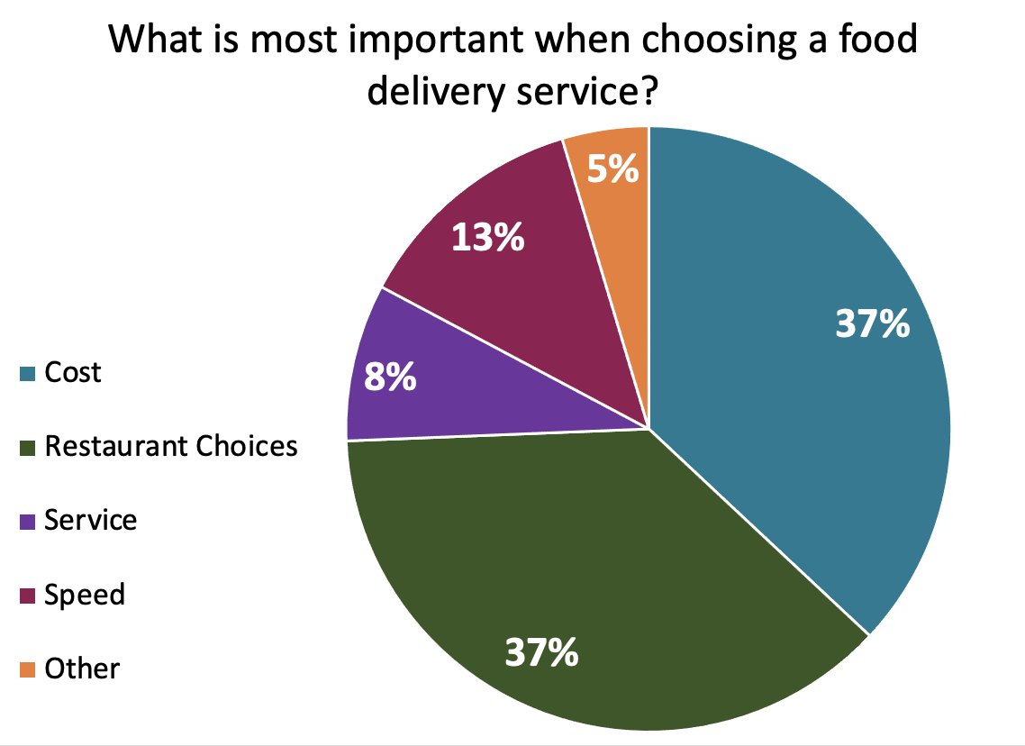
Weakness: Lack of Profitability & Loyalty
High Customer Acquistion Cost & Lack of Profitability
Since there are many competitors sharing the same market space, DoorDash is constantly trying to convince users to choose their service over rivals.
The company is spending a vast majority of their sales on marketing and promotions. In Q3 of 2020, DoorDash paid $290 million or 33% of revenues in marketing expenses.
DoorDash has never generated a profit with the exception of Q2 of 2020.
Cost and restaurant choices were what survey respondents identified as the two most important attributes when choosing a food delivery service.
Lack of Loyalty
Customers are not loyal to a particular food delivery brand
The average 6-month customer return rate amongst all delivery platforms is 21%
In the first quarter of 2021, 25% of DoorDash customers also used GrubHub
Customers have the power of choice

Slide 9
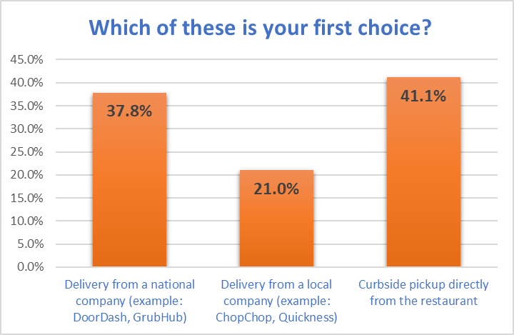
Threat: Local Competition. Suppliers Capitalize on a Growing Customer Segment
70% of consumers say they’d rather order directly from a restaurant, preferring that their money goes straight to the restaurant and not a third party (Upserve, 2021)
68% of consumers say they are more likely to purchase takeout from a restaurant than before covid. Even after dine-in fully returns, they will do more pickup orders directly from restaurants post pandemic than they did pre pandemic. (NRA survey)
From March-May 2020, over 60% of people ordering food through a website or app did so directly through a restaurant vs through a 3rd party service (Stratista, 2020)
The 333 Metro Richmond residents who were surveyed showed a similar preference for local with 41.1% choosing curbside pickup and 21% choosing a local delivery company.
Percentage of restaurants that added curbside pickup in 2020 (NRA):
Family Dining: 78%
Casual Dining: 73%
Fine Dining: 81%
Quick Service: 58%
Fast Casual: 77%
Coffee & Snack: 64%
About ~40% added online ordering
Top Reasons to Prefer Curbside?
Less Fees/Cheaper – 76
Better for Restaurants – 47
Quicker – 25
Food Quality/Temperature – 15
Don't Trust 3rd Party – 7
Easy – 6
Better Service – 6
Less Contact – 6
Notes:
During the pandemic, the restaurant industry got a lot of attention. In March and April 2020, we started hearing statistics that 75% of independent restaurants may close before the pandemic was over though that widely published number was not based on any real statistics or surveys. Other organization made statements claiming 1 in 5 would close permanently. Regardless of what was true, these statements spurred people to protect their favorite local restaurants. In Richmond, food groups formed on Facebook to support and bring attention to local restaurants. Combined the two main groups have over 47000 members. Two topics that come up constantly on these sites are tipping and delivery sites --- specifically not using delivery sites because of how much they cost restaurants. The sentiments along the line of “if you really want to help your favorite restaurant survive then go in person to get your order.”
Nationally, 70% of consumers say they’d rather order directly from a restaurant and between March and May 2020, over 60% of people ordering food through a website or app did so directly through a restaurant versus a 3rd party service. 68% of consumers say they are more likely to order takeout than they were pre pandemic and they will continue to order more often post pandemic.
In 2020, Restaurants, facing restrictions on in-restaurant dining, capitalized on these sentiments by adding curbside pickup options. In fact, 70% of restaurants added this service (see the breakdown by restaurant type on the screen). Many local restaurants did not have the ability for people to order online directly with them so they partnered with companies like Seamless so they could accept orders from their website. About 40% of restaurants claim to have added online ordering in 2020. Other restaurants avoided upgrades by pushing customers to the national and local delivery companies that had curbside pickup options. Some restaurants went to curbside and delivery only, operating as a ghost kitchen.
Now, a year after many made these adjustments, we asked “which of these is your 1st Choice – delivery from national company like doordash or grubhub. Delivery from a local company like ChopChop or Quickness. Or curbside pickup directly from the restaurant. We had also asked for zip codes and when analyzing we narrowed the data to those in the Richmond area since local companies don’t exist everywhere. This brough us to a sample size of 333 surveys. You can see the results on the first graph.
Curbside getting the largest share opens many questions about the future. Will this growing awareness of restaurants bottom line continue? How about the guilt people feel to pickup orders themselves – will that continue post pandemic? Will enough customers shift to curbside to give the restaurants power to negotiate lower commissions? To start to answer these questions, we first needed to know why 41% chose curbside . . . So, we asked in an open-ended question and categorized the answers. Most gave one answer but some gave up to 3. You can see these in the top right of the screen with the most popular reasons people preferred curbside being it is cheaper and better for restaurants. People also noted areas that reflected why they did not choose a national company such as cold food, service, contact, and not trusting 3rd parties.
Back to the first graph. Is preference tied to action? In other words, just because someone says curbside is their 1st choice does not mean they always choose curbside or even choose it most of the time. The second graph combines the questions “How many times did you order delivery over the past 60 days” with Which of these is your first choice: National delivery, local delivery or curbside.” 34% of those who preferred curbside say they have not ordered delivery in the past 60 days. 40% say they only have 1-2 times. Leaving only 25% of people who prefer curbside ordering more than once per month. In comparison, 81% of those who prefer a national delivery company order more than 1 times per month. So, peoples buying habits are in line with their preference.
What our research shows us is that customers who prioritize buying local WILL order directly through a restaurant if the restaurant makes it easy for them to do so. Can DoorDash win over this segment? Will this segment continue to grow pulling more customers away from DoorDash?

Slide 10
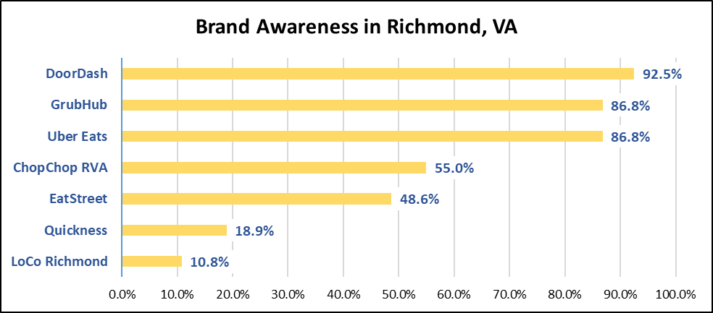
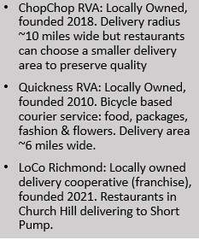
Threat: Local Competition. New Competition from Local Delivery Services
21% of Richmond residents surveyed said they would prefer to order from a local delivery company. 69 answered our open-ended question asking why they made that choice:
Support Local - 61
Better for restaurants - 11
Better Food Quality - 4
Better Service – 3
Convenience – 3
Fees – 3
Notes:
In the last slide we focused on the growing threat of customers ordering directly from a restaurant and focused on those picking food curbside. In addition to the 41% who prefer to order curbside, another 21% would like to order through a local delivery company. We sought to understand if these local companies would be popular enough to steal noticeable business from DoorDash if they popped up in every city or town? Delivery through a local company is not widely available but it is available in larger cities, and it is a growing trend. In Richmond, we do have local delivery companies and our research sheds some light on what could be possible nationally in the next years.
We asked our survey participants to mark all the brands they had heard of (top right graph). For this graph, we again limited our survey results to those living in Richmond since we are looking for awareness of national and local brands. As you can see, DoorDash has the highest awareness at 92.5%. What we are most interested in here is ChopChop RVA with a 55% awareness. Local brand Quickness, which is a bicycle based courier service founded in 2010, has 18.9% awareness and LoCo Richmond has 10.8% awareness even though it just opened in 2021.
Our next thought was “Are the Richmonders who say they prefer to order from local delivery companies even aware of the current local delivery options or are they a fan of local in theory.” To find out, we compared brand awareness from our sample that picked national delivery as their 1st choice to the sample that picked local delivery as their first choice. In the bar graph at the bottom of the slide you can see awareness of all three brands jump with 75% of those who want to order locally being aware of ChopChop RVA.
We wanted to go deeper into why 21% said they preferred delivery from a local company so we asked them and 69 people answered the open-ended question. 61 of the 69 respondents mentioned wanting to support a local business or keeping money local as part of their motivation. 3 specifically used the combination of Support local, lower cost to restaurants but still the convenience of delivery. 11 respondents specifically mentioned local delivery services being better for restaurants.
Combining our survey and research, 60% of consumers, or greater, want to buy directly from a restaurant but they want to do so online. Our results show that people see local delivery services as more fair to the restaurants than DoorDash and they get to support 2 local businesses at once (the local restaurant and the local delivery service). Based on the answers from those who preferred curbside, we hypothesize that local delivery would be the 2nd choice for this segment. So, if people stop going out of their way to pickup, or if restaurants stop offering curbide, then we expect the curbside demographic to switch to local delivery. For all these reasons, we see local delivery services as a growing threat to DoorDash. As these local companies pop up in new markets, we expect them to be successful but only if they can make ordering easy, get brand awareness and let the public know they are local and good for restaurants.
Bryce
Other facts:
One question we asked was which do you order from the most grub, uber, door or NA --- 63 picked NA (curb + local)
93% who prefer local delivery have ordered delivery in the past 60 days (do more curbside)

Slide 11
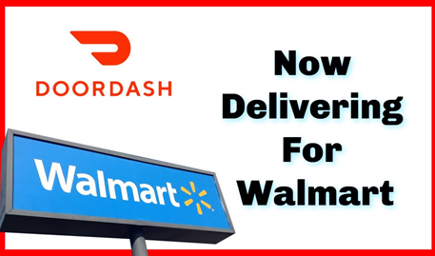

Opportunity: Growth & Diversification
“If DoorDash can capture even 5% of the convenience and grocery market in the next few years, it could mean revenue increases by more than 500%.” -DoorDash CFO Prabir Adarkar
Their mission: Allow any local merchant to offer delivery
Delivery for businesses from large hardware stores to independent small boutiques. “Market opportunities like convenience $225 billion and grocery $900 billion” (estimated by DoorDash CFO)
Expand awareness in: Pharmacy (Sam's Club same day prescription delivery), Alcohol, Catering, Bath & Beauty, Home & Office, Cleaning, Pets (PetSmart partnership), Baby, and Grocery
(61% from our survey selected they have had groceries & 50% for Pet supplies delivered from companies such as DoorDash, Instacart, Shipt, or GoPuff)
Expanding DoorDash Drive – gives every business their own on-demand delivery fleet service for day-to-day delivery operations – ex. Daily stock small retailers or order large orders. Other examples include mattresses, Christmas trees, and much more.
Explore more use of ghost kitchens and corporate catering - access to new customers in neighboring communities without the same overhead cost involved in opening additional stores.
Bets DoorDash is making: (+ Going Global)
Walmart Ventured - huge move into grocery delivery and also to power delivery networks for larger companies – many other business lines than just food (currently only offered in Atlanta)
Robotic Prep Company: Chowbotics (Salad vending machine – reduces risk of foodborne illness for hospitals, universities and grocery stores)
DoorDash software (Jimmy John’s has their own drivers but uses it)
Credit cards (Brand awareness, cross promotion, retain new members, incentivizing sign-ups)
The use of Data: Their data platform that drives intelligence and automation - a real-time prediction service called “Sybil”
They have 2-3X more employees with the word “Data” in their title than other engineering organizations
Notes:
First, I want to start you on the right side of the page.
Their mission is to allow any local merchant to offer delivery. Coming out of the gate, they wanted to be a technology logistics company – they started delivering food but always had everything else in mind.
Some examples would be everything from large hardware stores to independent small boutiques.
Their CFO claims market opportunities like convenience could bring in as much as $225 billion and grocery as much as $900 billion”
We think there is great opportunity in expanding awareness in the areas they already offer such as same day prescription delivery with Sam's Club or bath & beauty or pet supplies and of course Grocery.
I, for one, did not know they offered all of those options
(61% from our survey selected they have had groceries delivered from companies such as DoorDash, Instacart, Shipt, or GoPuff)
DoorDash Drive is another huge opportunity where they try to be a logistics company for restocking small retailers
Ghost kitchens and corporate catering are also other areas for potential expansion
Now on the left – Their CFO also claims capturing 5% of the convenience and grocery market in the next few years could mean revenue increases by more than 500%
And that's what they're attempting with Walmart – this really opens up their grocery market as well as non food items.
https://medium.com/@DoorDash/launching-the-doordash-platform-with-doordash-drive-37224cfd6d5b
https://www.youtube.com/watch?v=faKd3bKjD_w
https://help.doordash.com/merchants/s/article/What-Other-Services-does-DoorDash-Offer?language=en_US
https://www.supermarketnews.com/online-retail/cvs-taps-doordash-same-day-delivery-groceries-and-non-rx-items
https://www.cfodive.com/news/doordash-growth-plans-investments-q1-earnings-Prabir-Adarkar-/595907/
https://medium.com/@DoorDash/launching-the-doordash-platform-with-doordash-drive-37224cfd6d5b
https://larskamp.medium.com/how-doordash-built-the-most-incredible-go-to-market-playbook-ever-5e8f1d58f6cd
https://techcrunch.com/2020/12/10/early-doordash-investor-dismisses-froth-talk-says-company-could-grow-10x-from-here/?guccounter=1&guce_referrer=aHR0cHM6Ly93d3cuZ29vZ2xlLmNvbS8&guce_referrer_sig=AQAAACf-yw1vhCFaxhEBF6nfxYl1ayCXLCPgF8OhrZVzB11PBsLeJvEJzf90mBfVOGXmRcQBvH5WVWE8e2qIG420WUnUZmieEchmSxBiygiDd8bHZD5tZn4zetMua_L6ji4dIKRmrRDtbD4tFnQDf7L9iigxRZU-rx25UtLyNg73wuuD

Slide 12
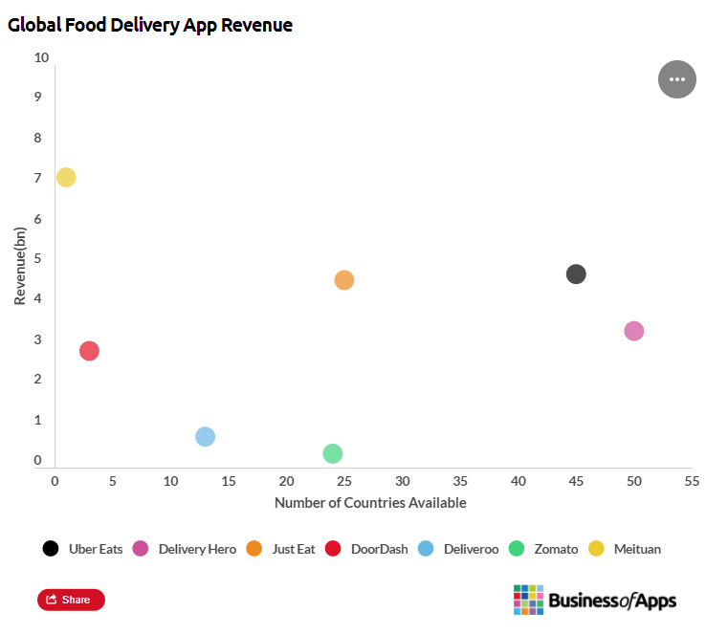
Opportunity: Growth & Diversification
# of Cities: over 4,000 - 56% market share in US – all 50 states
Global Growth - Countries: US, Canada, Australia, and now Europe (as of April 30, 2021) and Japan (as of Jun 9, 2021) (Vs Uber Eats: 45 countries)
Started out in the suburbs (have 58% market share in the suburbs, higher than their overall market share)
Expand in high-density metropolitan areas (high amount of disposable income)
Using data and satisfied customer reviews to advertise in new cities
Autonomous deliveries provide opportunities to expand to rural areas and food deserts: Decrease delivery times & Cost
Providing food and restaurants in food deserts
Just less than 50% of the US population have low access to brick and morter grocery
Drones
Coolers/heated for food
When expanding: “Launchers conduct demographic research in that market and will literally go door-to-door to engage with merchants. Based on their research, they bring on the most desirable merchants. The whole process takes six to eight weeks.”
“DoorDash also provides education for merchants, e.g. how to optimize their dishes for delivery and pick-up, or what to do to attract new customers.”
Notes:
# of Cities
Global Growth
The chart on the right shows how far behind they are in other countries such as Uber Eats in 45 countries
But this is because of their strategy in choosing markets and ares to expand to.
They were able to take control of the suburbs because of the way the execute their strategy in expanding
This process is heavily data driven along with visiting merchants door to door (Bottom right) to bring on the most desirable merchants.
The whole process takes 6 – 8 weeks.
atonomous delivery is also an opportunity to expand to rural and under served areas
Just less than 50% of the US population have low access to brick and morter grocery
https://larskamp.medium.com/how-doordash-built-the-most-incredible-go-to-market-playbook-ever-5e8f1d58f6cd
https://www.businessofapps.com/data/food-delivery-app-market/
https://larskamp.medium.com/how-doordash-built-the-most-incredible-go-to-market-playbook-ever-5e8f1d58f6cd

Slide 13
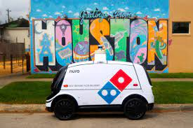
Opportunity: Innovation through Autonomous Delivery
A company by the name of NURO is partnering with major companies like Dominos, Kroger, and CVS Pharmacy to test the autonomous delivery concept in select locations across the United States. Investments in other autonomous and drone fleets are happening amongst large merchants like Chipotle, Amazon, and Kroger.
Reasons to move towards Autonomous Delivery Vehicles
Autonomous delivery fleets would allow cheaper delivery fees for customers
Security of goods and food – customer receives unique pin to open the robot
More efficient distribution of goods from merchant to customer (no wait times or dasher errors)
Temperature control to keep perishable items hot/cold.
Food deserts and low income areas would have the ability to fresher and healthier options through autonomous delivery. No bias in delivery area or delivery cost.
Door Dash – Partnership with General Motors and Cruise Automation (2019 – San Fransisco)
.
​
Autonomous Delivery Vehicle -
A self-driving delivery vehicle or robot that delivers goods from stores to customers' homes without the need of a driver. ​
​
Notes:
Another opportunity we discovered was the opportunity of innovation through Autonomous Delivery.
Autonomous Delivery Vehicles are a self driving delivery vehicle or robot that has the ability to delivers goods from stores to customers' homes without the need of a driver.
A company by the name of NURO has been partnering with major companies like Dominos, Kroger, and CVS Pharmacy in designated test markets to try our these autonomous vehicles in delivering their product to customers. The delivery service industry as a whole have been trying to solve certain obstacles like cheaper delivery fees, more efficient means of transporting goods, and larger geographical reach as a way to retain customers. We even saw in our survey that people would opt out of getting a food delivery service and pick curbside instead to ensure lower cost, no tampering of food, and control of the temperature of their food. Companies like dominos are choosing innovations like Nuro delivery vehicles to eliminate some of these issues. Autonomous delivery vehicles allow for cheaper delivery fees to customers, secure transportation of goods, more efficient delivery routes, and temperature control compartments. Another plus side of opting into the autonomous delivery vehicle is the ability to visit food deserts and low income neighborhoods who may not have the option for healthier, fresher options. Door Dash announced in 2019 that it would be partnering with General Motors and Cruise Automation to test a protype of these type of vehicles in San Fransico, it will be interesting how that partnership progresses into other markets.

Slide 14

Loyalty & Profitability Local Competition Growth & Diversification Innovation through Autonomous Delivery
What are the key dilemmas and/or opportunities that DoorDash must address to grow?
Notes:
In conclusion, we were asked to investigate potential strengths, opportunities, threats, and weaknesses and we found that loyalty, local competition, growth and diversification, and innovation through autonomous Delivery were the main ones to focus on. We look forward to investigating and presenting these even further in future classes. Any Questions?

Slide 15
References
https://upserve.com/restaurant-insider/online-ordering-statistics​
https://www.statista.com/statistics/1170545/us-consumers-direct-vs-third-party-food-delivery-online-orders-coronavirus/​
https://www.qsrmagazine.com/consumer-trends/restaurants-2021-takeout-and-delivery-now-essential-customers​
https://www.sec.gov/Archives/edgar/data/1792789/000119312520292381/d752207ds1.htm​
https://secondmeasure.com/datapoints/food-delivery-services-grubhub-uber-eats-doordash-postmates/ ​
https://www.indigo9digital.com/blog/fooddeliveryappprofitability​
https://medium.com/@DoorDash/the-doordash-story-b370c2bb1e5f​
https://larskamp.medium.com/how-doordash-built-the-most-incredible-go-to-market-playbook-ever-5e8f1d58f6cd​
https://appther.com/blog/doordash-business-model-how-does-doordash-make-money/​
https://progressivegrocer.com/doordash-will-be-3rd-largest-e-commerce-banner-after-amazon-walmart-report​
https://larskamp.medium.com/how-doordash-built-the-most-incredible-go-to-market-playbook-ever-5e8f1d58f6cd​
https://medium.com/@DoorDash/launching-the-doordash-platform-with-doordash-drive-37224cfd6d5b ​
https://www.youtube.com/watch?v=faKd3bKjD_w​
https://help.doordash.com/merchants/s/article/What-Other-Services-does-DoorDash-Offer?language=en_US​
https://www.supermarketnews.com/online-retail/cvs-taps-doordash-same-day-delivery-groceries-and-non-rx-items​
https://www.cfodive.com/news/doordash-growth-plans-investments-q1-earnings-Prabir-Adarkar-/595907/​
https://medium.com/@DoorDash/launching-the-doordash-platform-with-doordash-drive-37224cfd6d5b​
https://larskamp.medium.com/how-doordash-built-the-most-incredible-go-to-market-playbook-ever-5e8f1d58f6cd​
https://techcrunch.com/2020/12/10/early-doordash-investor-dismisses-froth-talk-says-company-could-grow-10xfromhere/?guccounter=1&guce_referrer=aHR0cHM6Ly93d3cuZ29vZ2xlLmNvbS8&guce_referrer_sig=AQAAACfyw1vhCFaxhEBF6nfxYl1ayCXLCPgF8OhrZVzB11PBsLeJvEJzf90mBfVOGXmRcQBvH5WVWE8e2qIG420WUnUZmieEchmSxBiygiDd8bHZD5tZn4zetMua_L6ji4dIKRmrRDtbD4tFnQDf7L9iigxRZU-rx25UtLyNg73wuuD

